Slide 1

Introduction to SDLC Planning Phase
Welcome to Lesson 2 on Software Development Life Cycle (SDLC). In this lesson, we will learn all about the planning phase, which is the first phase in the SDLC. This phase is crucial as it helps us understand why the software should be developed and how it will meet business objectives.
AB
by Adaeze Badipe

Slide 2

Recall
Planning Phase
1
2
3
4
Gather Requirements
Design Architecture
Create Project Plan
Obtain Approvals
Identify the user's needs, what they expect, and define the scope of your project.
Develop a high-level architecture that identifies all the components required in the system.
Develop a detailed project plan that includes a timeline, budget, and resource allocation for all project activities.
Get approvals from stakeholders on the requirements, scope, and project plan. The planning phase is complete once all approvals are obtained.

Slide 3
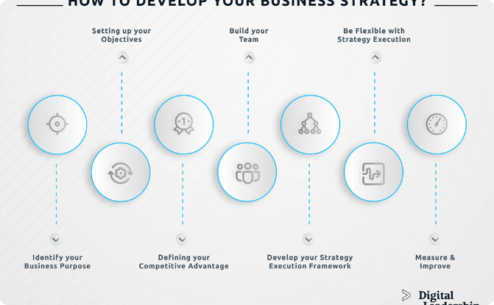
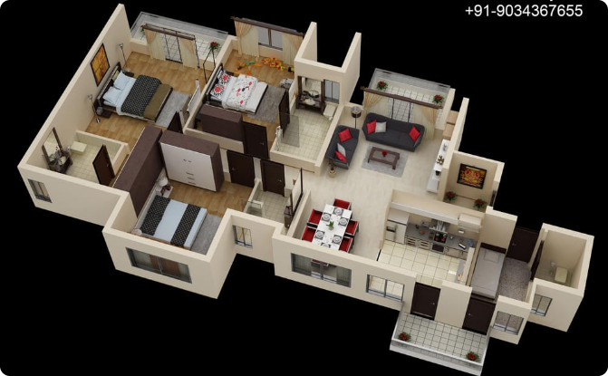
Why is Planning Phase Important?
Business Strategy
Architecture Design
The planning phase identifies how the new system will achieve business strategic objectives such as lowering costs, competitiveness in the market, and efficiencies.
The high-level architecture design determines the components required for the new system, giving an initial scope of the problem.

Slide 4

Project Initiation/Feasibility Steps
1
Business Value
2
Architecture Design
Determine the business value of the software to the organization, such as lowering costs, competitiveness, and efficiencies in the market.
Design a high-level architecture to determine the components that the new system will require.
3
Resource Planning
Resources, costs, time, benefits, and other items must be considered at this stage.

Slide 5
Project Management Steps
1
Detailed Project Plan
Create a detailed project plan that includes a timeline, budget, and resource allocation for all project activities.
2
Stakeholder Approvals
Get approvals from stakeholders on the requirements, scope, and project plan.
3
Project Completion
The planning phase is complete once all approvals are obtained.

Slide 6
Understanding the Initial Client Request
Feasibility Study
Explore and gain understanding of the initial client request or project brief to ensure project feasibility.

Slide 7
The Purpose of Planning Phase
Determine the solutions to the identified problems.
Consider resources, costs, time, benefits, and other items.
Provide an initial scope of the problem and identify business value

Slide 8

Creating Detailed Project Plan
1
Timeline
2
Budget
Create a timeline that outlines the project's activities and their deadlines.
Allocate resources and determine the budget for all project activities.
3
Resource Allocation
Determine resource allocation throughout the project.

Slide 9
Stakeholder Responsibilities
Project Sponsor
Project Manager
Development Team
Provide financial support
Develop project plans
Approve project plans
Allocate resources
Communicate with stakeholders
Ensure project aligns with business objectives
Monitor project progress
Develop new system
Test new system

